Slide 1
Optical Matched Filter
Ethan ross
OPTI 8206 Final project

Slide 2
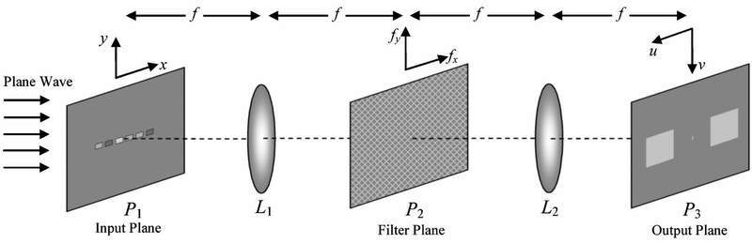
Introduction
What is a matched filter?
Spatial frequency filter
Matches image from a set of similar images
Locates images within images
Character recognition, wind velocities, etc.
Simple set up: 4f optical system
Filter placed in Fourier plane
Project objective: optical character recognition
Locate specific alphanumeric characters in input

Slide 3
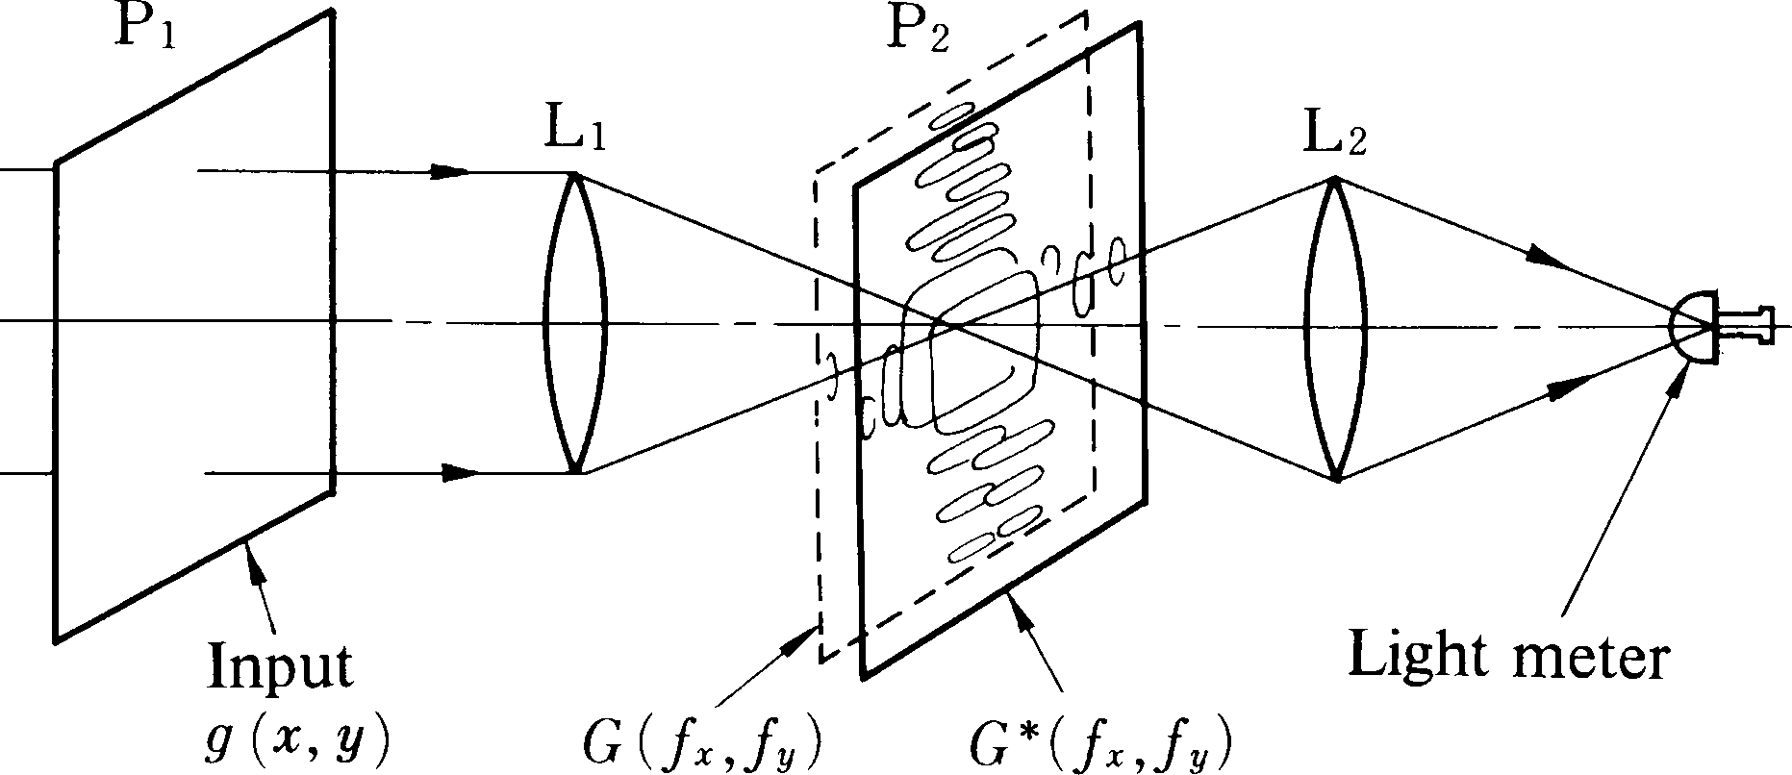
Theory: basic method
Input – front focal plane of L1
Input = g(x,y), ℱ{input} = |G(ξ,ψ)| e^{jϕ(ξ,ψ)}
Filter – Fourier plane
If filter is “matched” with the input, max output at light meter.
Filter = |G(ξ,ψ)| e^{-j ϕ(ξ,ψ)}
If phases match, plane wave with amplitude |G(ξ,ψ)|² will converge to light meter.
If phases do not match, will not get plane wave and will not converge to light meter.
Iizuka, Keigo. Engineering Optics. New York, NY: Springer, 2010. Print.

Slide 4
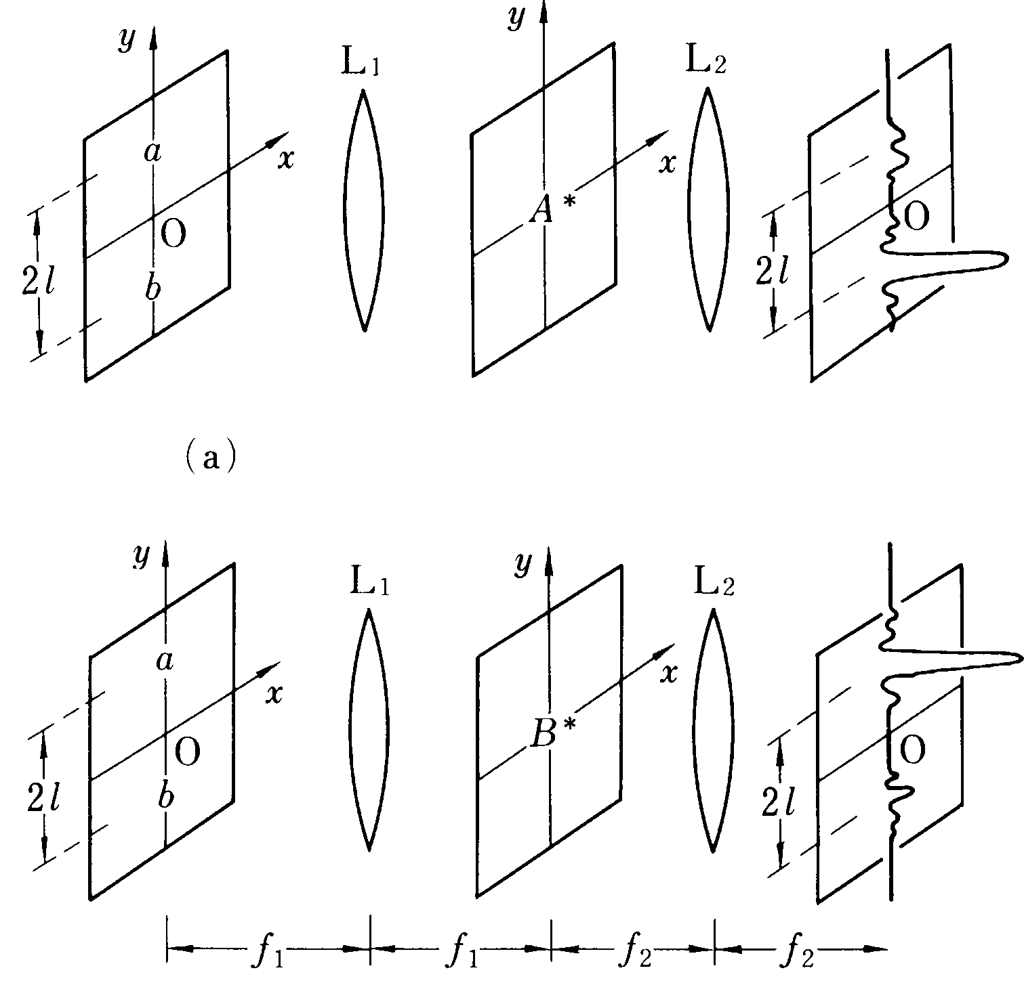
Theory: character recognition (1)
System can also be used to locate figures within a larger image
Consider input consisting of two letters: ‘a’ and ‘b’.
Let input = g(x,y) = a(x,y-l) + b(x,y+l)
Want to locate letter ‘a’
Filter = A*(ξ,ψ)
In Fourier plane…
G(ξ,ψ) A*(ξ,ψ)
Lens L2 takes FT…
ℱ{G(ξ,ψ)}*ℱ{ A*(ξ,ψ)}
Iizuka, Keigo. Engineering Optics. New York, NY: Springer, 2010. Print.

Slide 5
Theory: character recognition (2)
Need to simplify: ℱ {G(ξ,ψ)}*ℱ { A*(ξ,ψ)}
Duality Property of Fourier transform
ℱ{ℱ{g(x,y)}} = g(-x,-y)
Fourier transform of conjugate w/ Duality Property
ℱ{ A*(ξ,ψ)} = a*(x,y)
We get…
a*(x,y)*a(-x,-y-l)+a*(x,y)*b(-x,-y+l) or
[a(x,y)*a*(-x,-y-l)+a(x,y)*b*(-x,-y+l)]*
Iizuka, Keigo. Engineering Optics. New York, NY: Springer, 2010. Print.

Slide 6
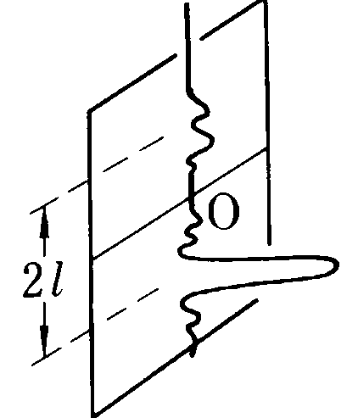
Theory: character recognition (3)
Convolution to correlation
f(x,y)*g* (-x,-y)= f(x,y)★g(x,y)
Applying this, the output of the 4f system is…
First term → large peak at (0,-l)
Second term → small peak at (0,l)
Output inverted relative to input
‘a’ now at –l, not +l
[a(x,y)★ a(x,y-l)+a(x,y)★ b(x,y+l)]*
Iizuka, Keigo. Engineering Optics. New York, NY: Springer, 2010. Print.

Slide 7
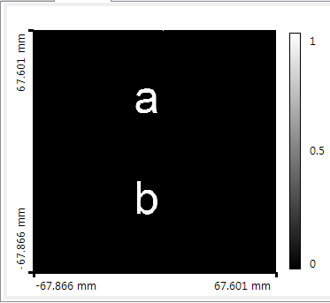
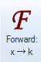
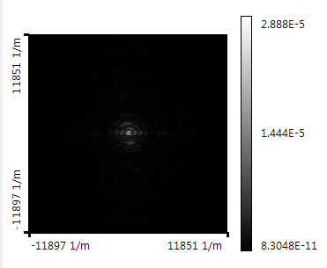
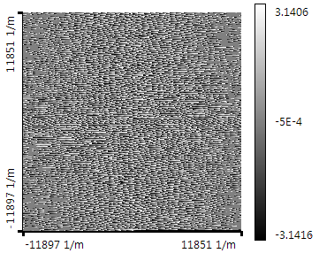
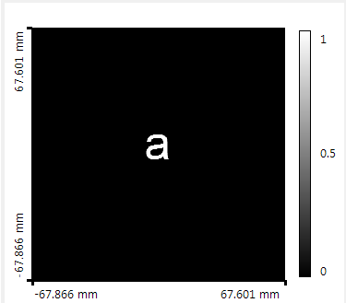
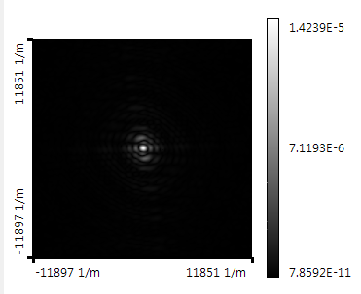
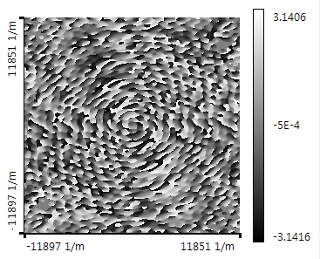
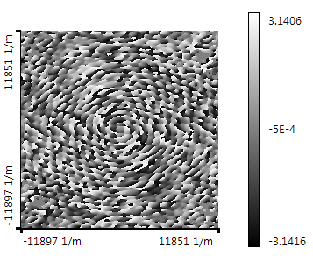
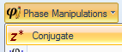
Test #1 in VirtualLab (1)
Demonstrated this exact system using VirtualLab

Slide 8
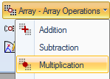
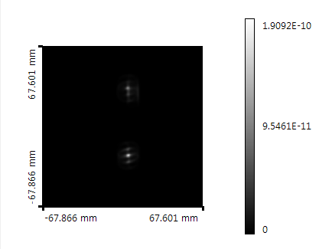
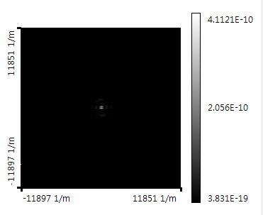
Test #1 in VirtualLab (2)
FT of input
FT of target
=

Slide 9
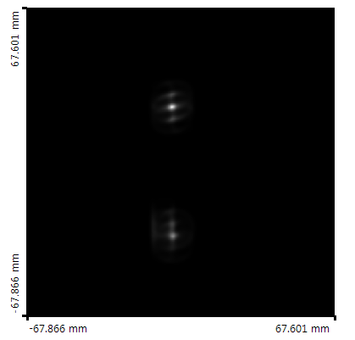
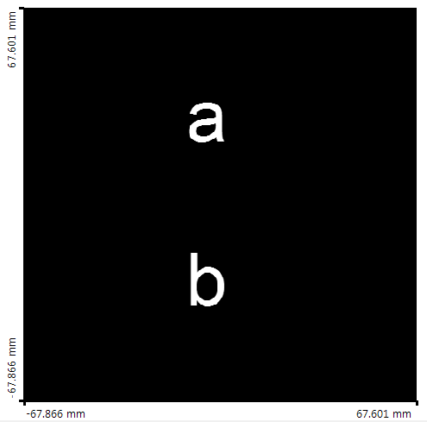
Test #1 in VirtualLab (3)
Final output:

Slide 10
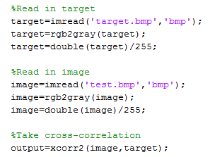

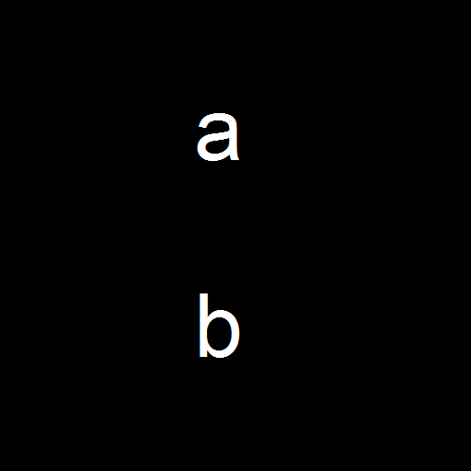
Test #1 in MatLAB (1)
Double check results with MatLAB
Take cross-correlation of image and target
Result should be identical to VirtualLab
target
input

Slide 11
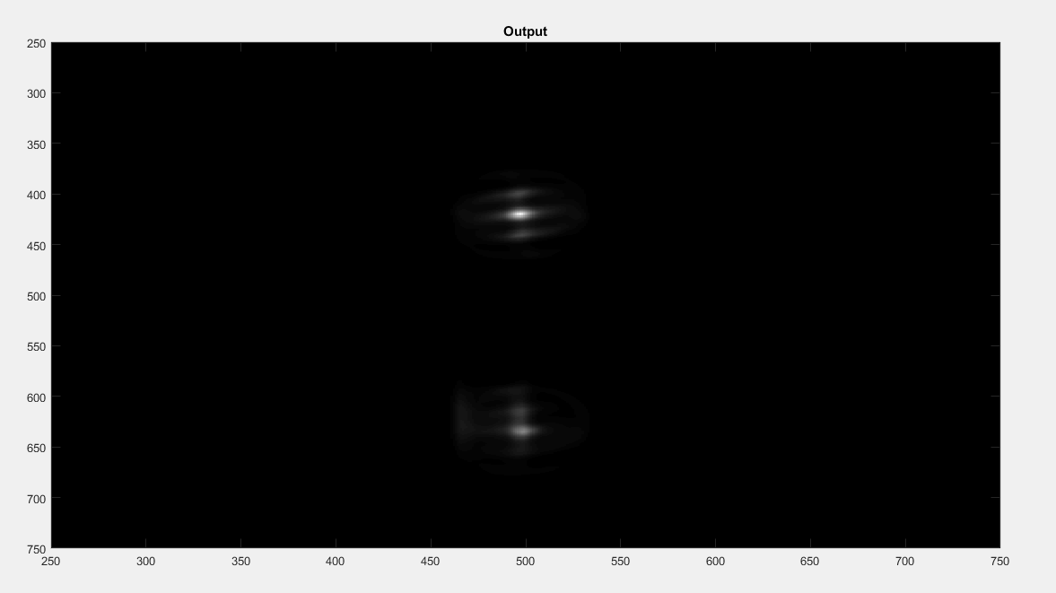
Test #1 in MatLAB (2)
Final output:

Slide 12
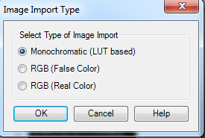
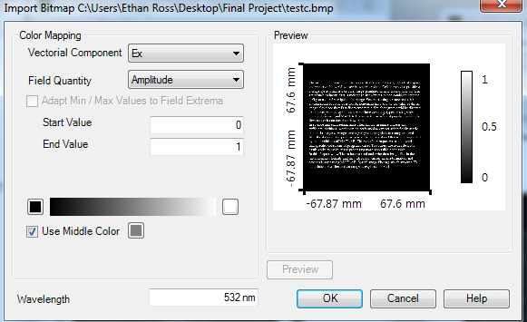
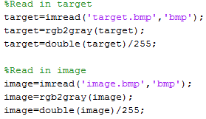
Image Preparation
Saved all input images and target images as 24 bit RGB bitmap files
Three colors: red, green, blue
8 bits (0-255) per color
Took greyscale of each image in both VL and MatLAB before inserting into system

Slide 13
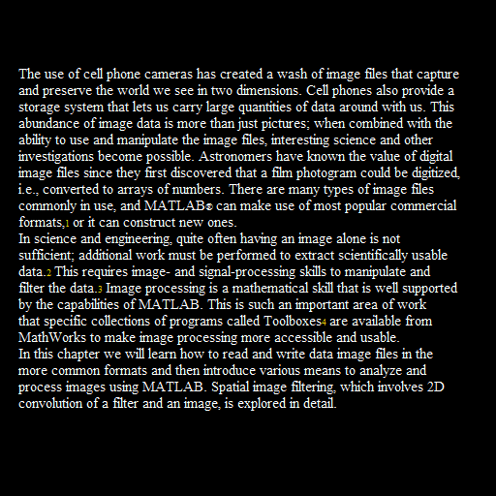

Test #2
Now test system with a more complex input function g(x,y)
Two paragraph input
Locate all capital A’s

Slide 14
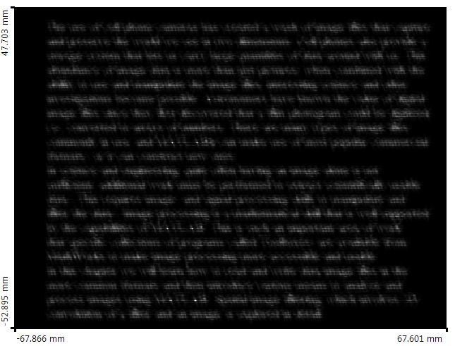
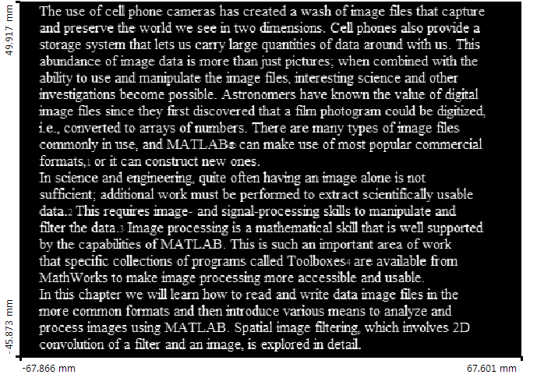
Test #2 in VirtualLab
Output
Input

Slide 15
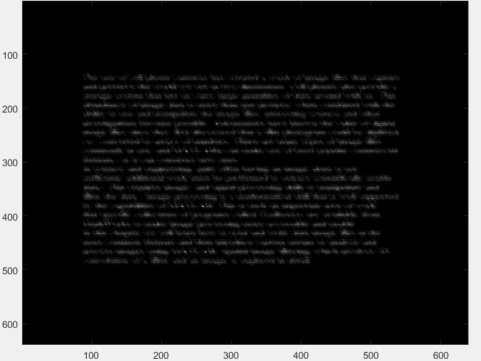
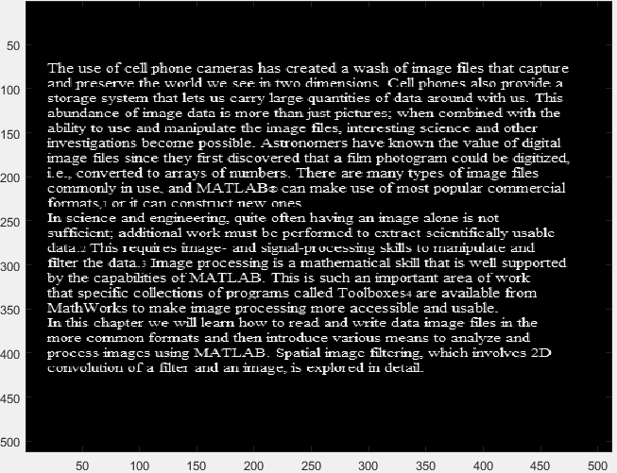
Test #2 in MatLAB
Output
Input

Slide 16
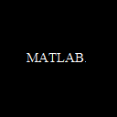
Test #3
Can we locate a string of characters? A word?
Two paragraph input
Locate all instances of the word “MATLAB”

Slide 17
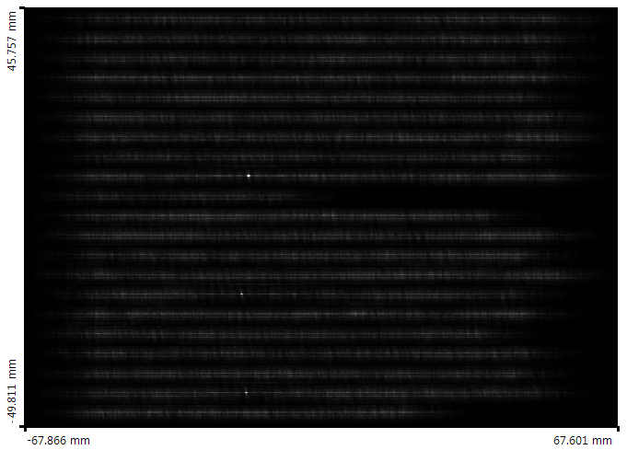
Test #3 in VirtualLab
Output
Input

Slide 18
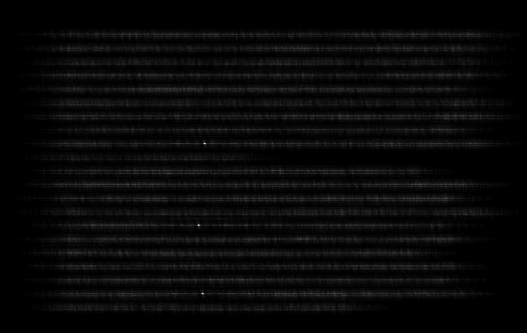
Test #3 in MatLAB
Output
Input

Slide 19
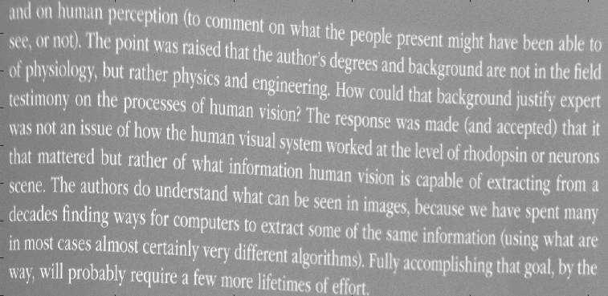
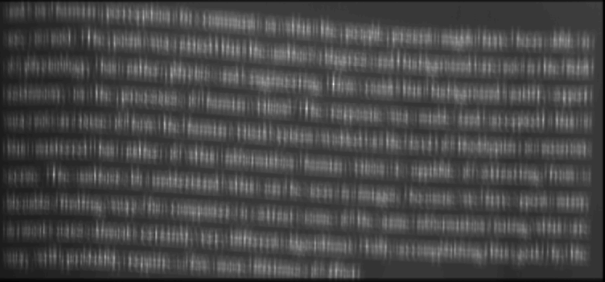

Next Steps (1)
Let image input be an actual photograph
Not totally dark background
Complicates target matching

Slide 20
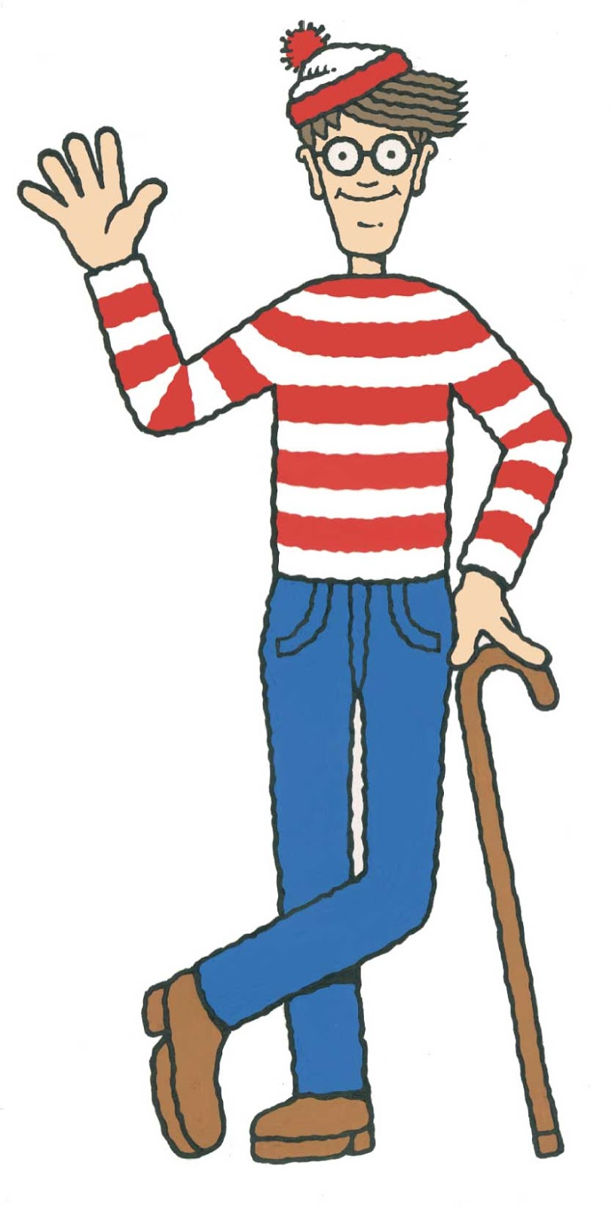
Next Steps (2)
Even more complicated inputs
Not alphanumeric characters
A face?
Attempt to locate Waldo with matched filter

Slide 21
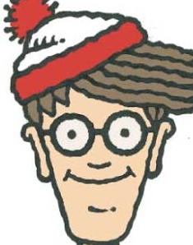

Next Steps (3)
Complications:
Waldo not the same in every image
Size, expression, orientation of head, illumination, etc.
Resulting peaks not as distinct

Slide 22
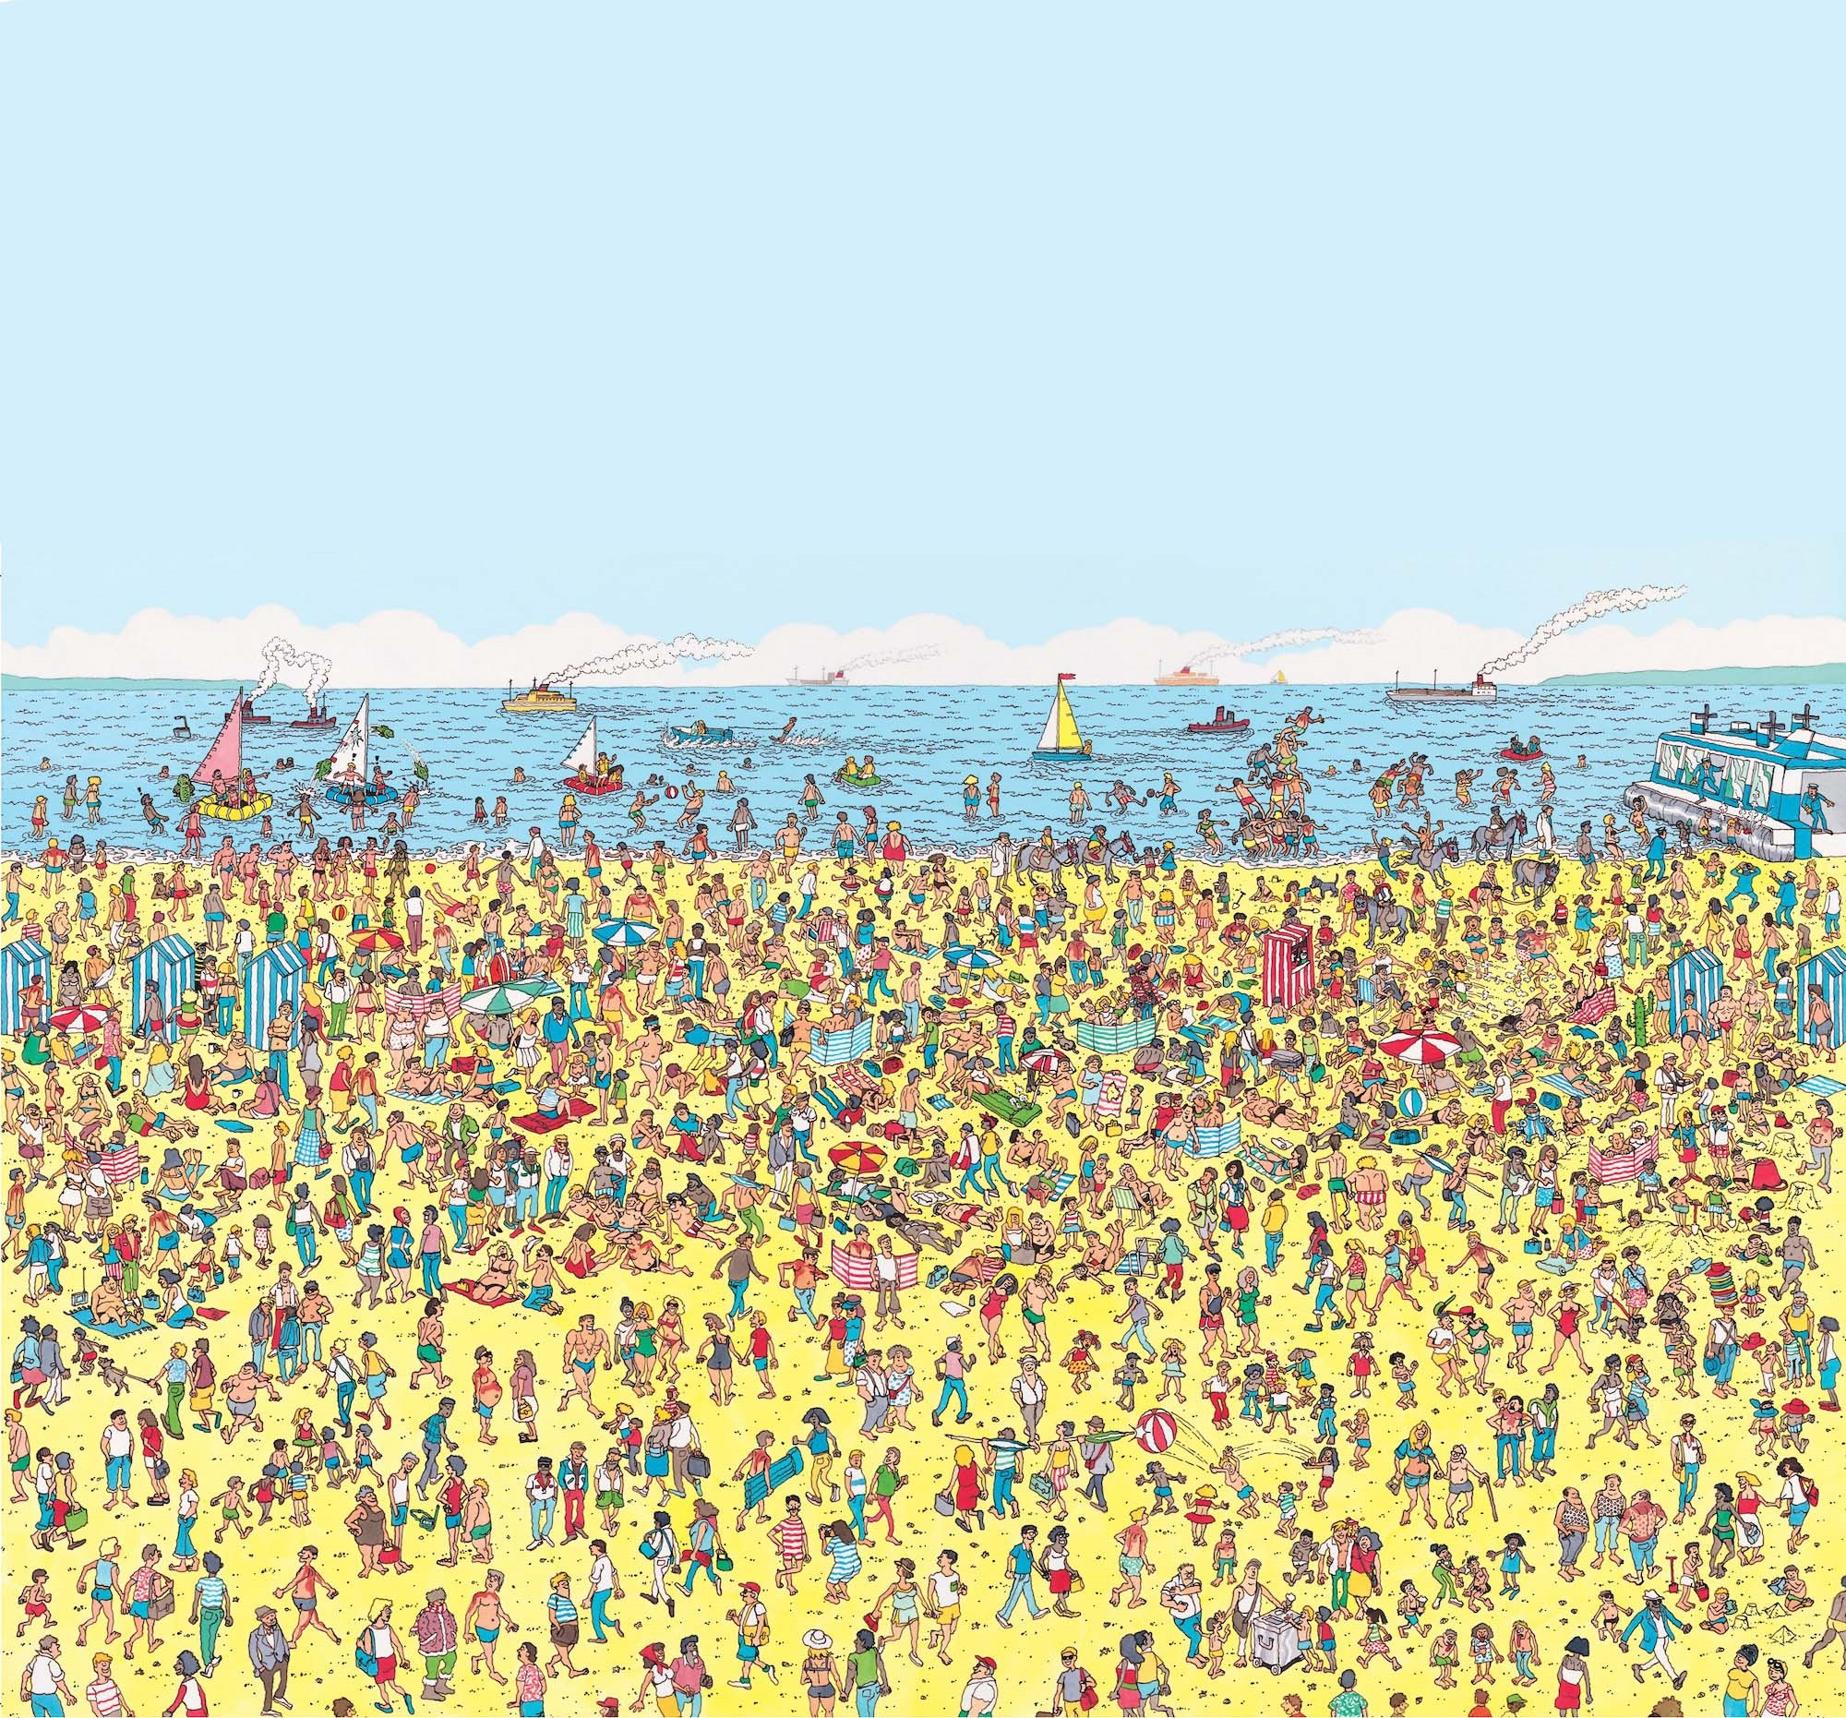

Slide 23
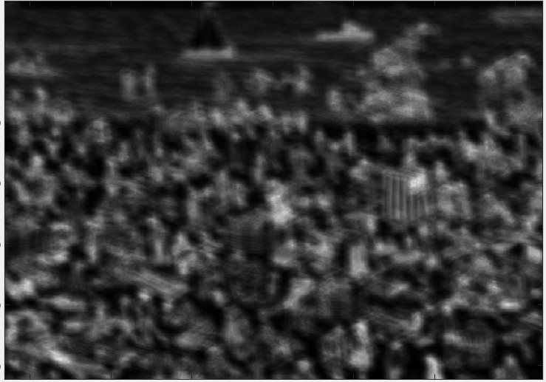
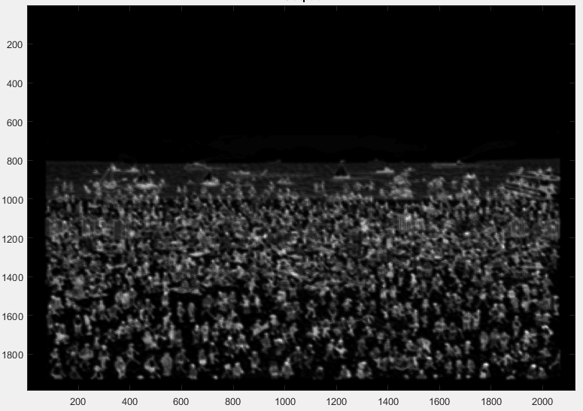
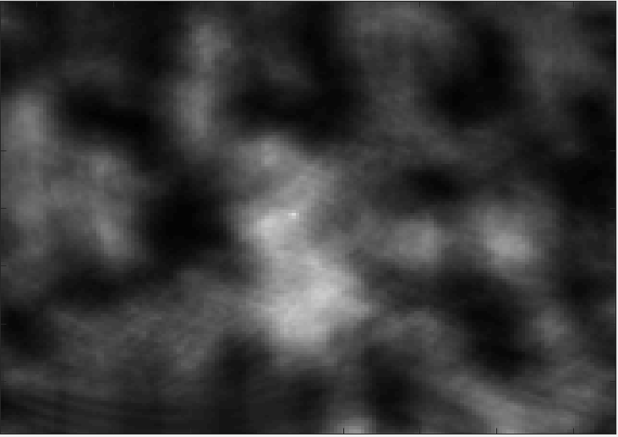

Slide 24
RECAP
Demonstrated character recognition for simple and complex “binary” inputs
Single character and a string of characters
Further exploration
Improve matched filter with a real photographic input
Improve target definition
Improve matched filter with facial recognition (Waldo)
Multiple filters

Slide 25
Resource
Iizuka, Keigo. Engineering Optics. New York, NY: Springer, 2010. Print.

Slide 26
Questions?

